Slide 1
ANALYSIS OF THALASSEMIA
ASSESSING PREVALENCE,GENETIC FACTORS AND HEALTHCARE IMPLICATIONS

Slide 2
OUR TEAM
ZAINAB JUNAID : BDSF22M005
LARAIB ZAFAR : BDSF22M012
USWAH FATIMA : BDSF22M015
MUBASHRA IFTIKHAR : BDSF22M022
IQRA ISHAQ : BDSF22M023

Slide 3



Surveyed Thalassemia Centers
SUNDAS FOUNDATION
THALASSAEMIA FEDERATION PAKISTAN
FATMID FOUNDATION
In the heart of these Thalassemic Centers, hope meets care, fostering strength and resilience for those on a journey of healing.

Slide 4
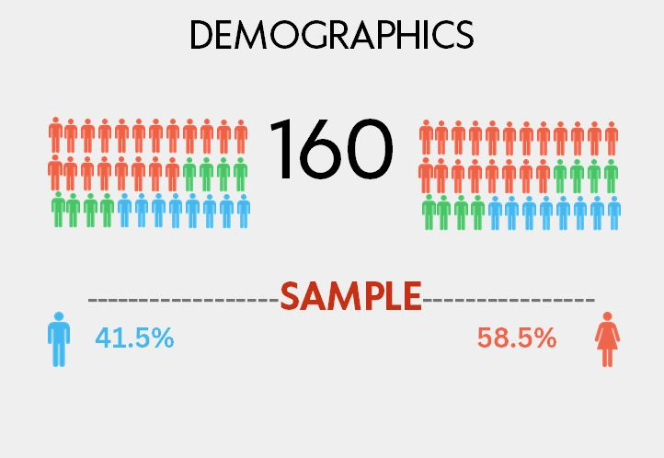
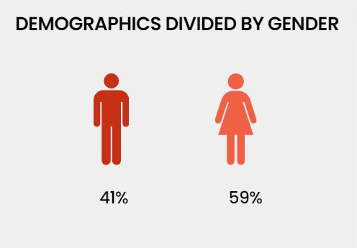
DEMOGRAPHICS
Sample Size
Gender

Slide 5
FORMAT
TOTAL OF 38 QUESTIONS , CATEGORIZED AS:
Patient Medical History
Access to Healthcare
Type of Thalassemia
Severity of Symptoms
Ferritin Level
Primary Healthcare Provider
Access to Healthcare Resources
Quality of Life
Family History
Consanguineous Marriage
Premarital Screening for Thalassemia
Genetic Counseling Before Marriage
Physical Health
Psychological Health
Financial and Social Aspects

Slide 6
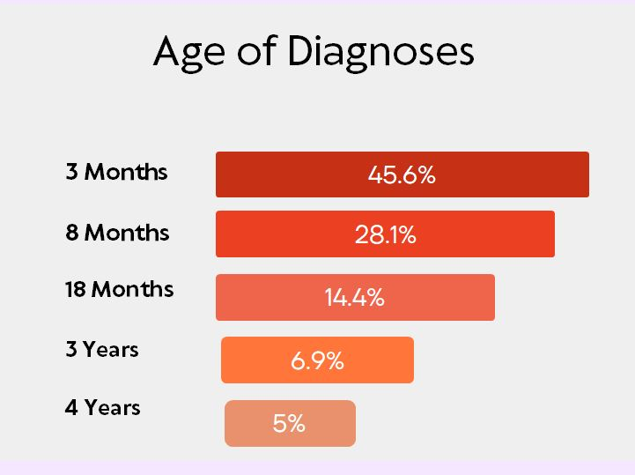
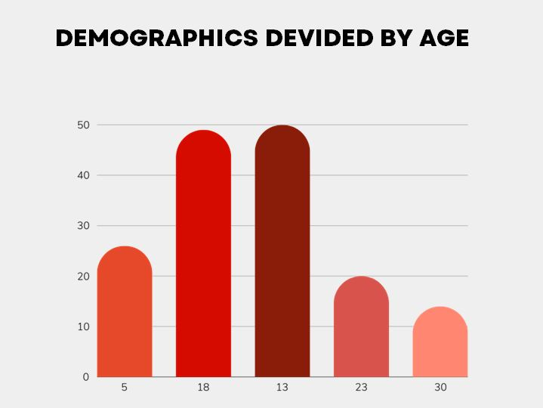
AGE
AGE OF DIAGNOSIS

Slide 7
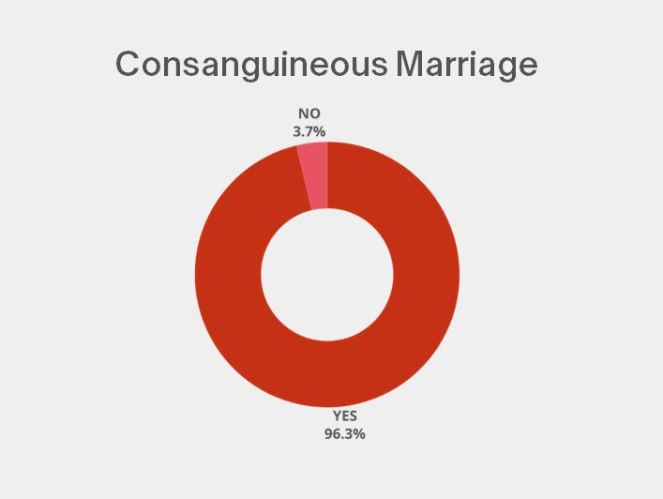
Consanguinity: A Key Factor
HO:
H1:
The proportion of cousin marriages is 80%.
The proportion of cousin marriages is greater than 80%.
H0: p = 0.80
H1: p > 0.80
Z-calc: 2.3735
Z-tab: 1.645
Assuming equal variances
Reject the null hypothesis. The proportion of cousin marriages is greater than 80%

Slide 8
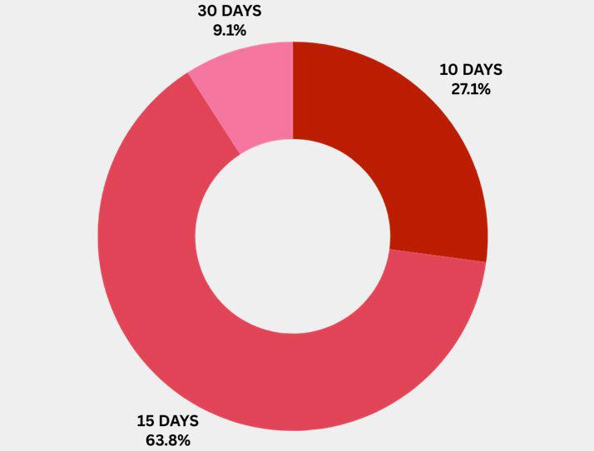
Blood Transfusions
The proportion of thalassemic patients who receive blood transfusions every 15 days is not 60%.
The proportion of thalassemic patients who receive blood transfusions every 15 days is 60%.
HO:
H1:
The proportion of thalassemic patients who receive blood transfusions every 15 days is not 60%.
z-statistic: 0.25820
z-tab: 0.25820
Significance level= 0.05
Fail to reject null hypothesis. ACCEPTED

Slide 9
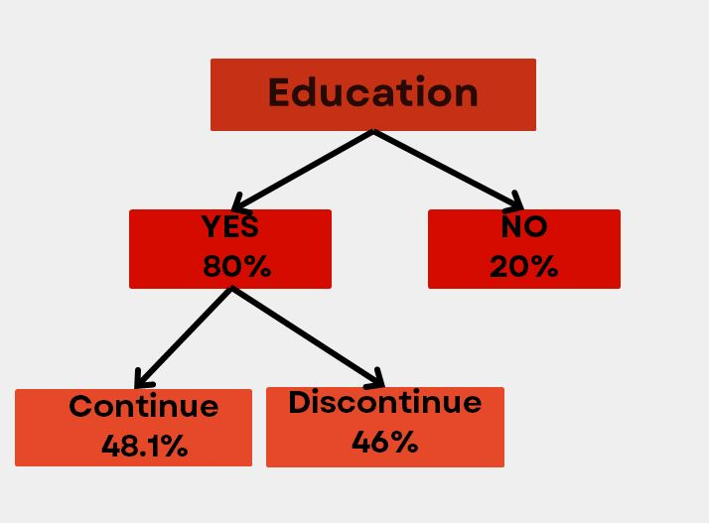
Education
The proportion of thalassemic children who did not receive formal education is equal to 0.40
HO:
H1:
The proportion of thalassemic children who did not receive formal education is not equal to 0.40.
z-stat: -4.905
z-tab: 1.96
Significance level= 0.05
Fail to reject null hypothesis

Slide 10
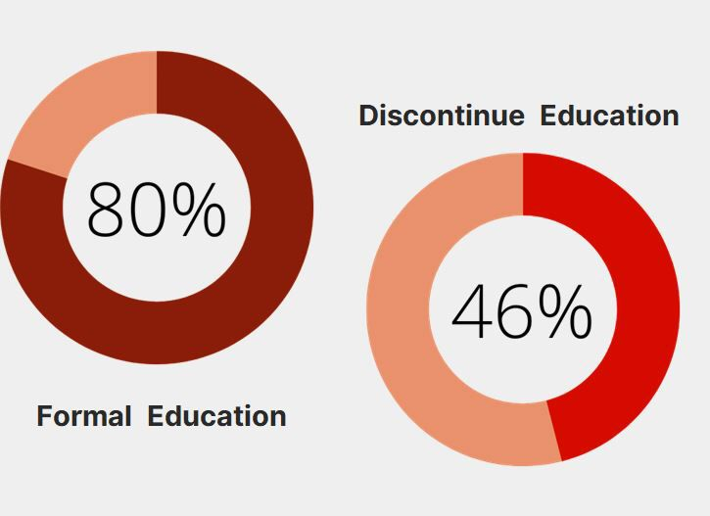
Education
The proportion of thalassemic students who discontinue their education is equal to 0.30 .
HO:
The proportion of thalassemic students who discontinue their education is not equal to 0.30.
H1:
z-stat:1.38013
z-tab: 1.96
Significance level= 0.05
Reject null hypothesis

Slide 11
Quality of Life
Social relations & moral dependency
Psychological distress
Physical Health
Financial Burden
“Crafted with precision, our QOL questionnaire draws inspiration from the WHOQOL framework, illuminating the multifaceted dimensions of well-being.”

Slide 12
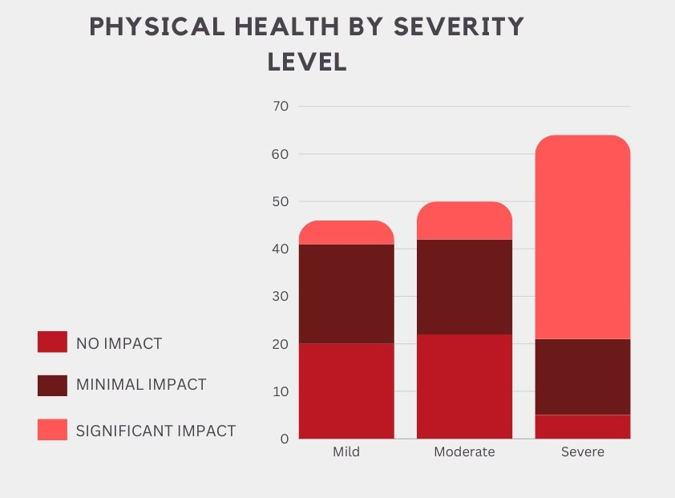
1. Physical Debilitation
HO:
H1:
The mean dependency level for minors is equal to the mean dependency level for adults.
There is no significant difference in the mean impact scores for physical health across different severity levels.
There is a significant difference in the mean impact scores for physical health across different severity levels
F-stats: 12.2679
p-value: 1.4e-05
Significance level= 0.05
At 95% Confidence level ,we reject the null hypothesis. There is a significant difference in mean impact scores.

Slide 13
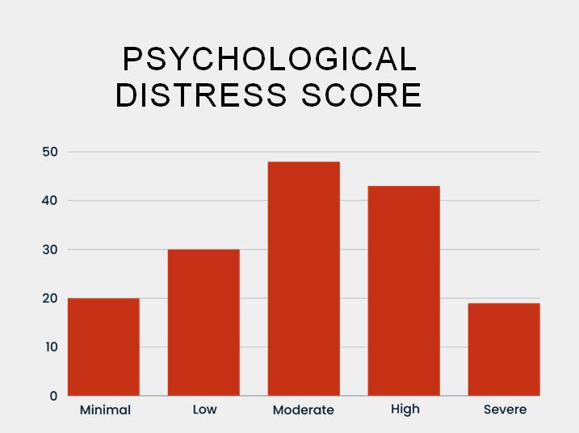
2. PSYCHOLOGICAL STRAIN
HO:
H1:
The mean dependency level for minors is equal to the mean dependency level for adults.
The population mean of psychological distress scores is the same across all severity levels of thalassemia.
At least two population mean of psychological distress scores is different across severity levels of thalassemia
F-statistic: 1.5802
p-value: 0.2091
Fail to reject the null hypothesis. At 95% Confidence level, we fail to reject our Null Hypothesis of equal mean, hence there is no significant difference in mean distress score.

Slide 14
3. Dependency Challenge
HO:
H1:
The mean dependency level for minors is equal to the mean dependency level for adults.
The mean dependency level for minors is equal to the mean dependency level for adults.
The mean dependency level for minors is not equal to the mean dependency level for adults.
H0: μ_minors = μ_adults
H1: μ_minors ≠ μ_adults
t-statistic: 3.218
t-tabulated:1.97
Reject the null hypothesis. There is a significant difference in means.

Slide 15
4. Financial Burden
HO:
H1:
The mean dependency level for minors is equal to the mean dependency level for adults.
The distribution of "Treatment Expense Level" is independent of the "Finance Cycle
The distribution of "Treatment Expense Level" is not independent of the "Finance Cycle."
Chi-square stats: 40.1024
p-value: 4.12e-08
Fail to reject the null hypothesis. There is no significant difference in mean distress scores.

Slide 16
DONATE BLOOD!
We urge you to

Slide 17
Our Messege
"Unite against thalassemia! Your contribution matters—whether it's joining the fight against this condition or donating blood to aid those affected. Together, we can make a difference in the lives of individuals battling thalassemia."

Slide 18
Thanks!
Do you have any questions?
Thaasdfghjkjtrewefghnhgfdssdfgbfeweeffewedffewedfgfedffgfgbgfefgbfefgbgefgefgefgefgrefnks

